Slide 2
INTERNAL AUDIT & RISK -
MANAGEMENT’S PERSPECTIVE
CA LAKSHMI R RAO

Slide 3
INTERNAL AUDIT EVOLUTION
For many years internal auditing was viewed as a necessary evil. Auditors were the inside people who tested the process to prevent outside audit surprises. However, in the past two decades auditors began to discuss the relationship between risk and control and found a role in process efficiency and effectiveness.
Today the definition of internal auditing places in partnership with management and governance. Auditors help increase the chances of achieving strategic and business objectives through assessing control, risk management, and governance.

Slide 4
Cont.…
The world is witnessing rapid development and changes in the business environment with artificial intelligence, thus business organizations are moving to develop effective structures, processes, and reengineering their operations, to add some accountability in line with their need for more relevant and reliable information for decision-making.
How to manage risk rather than avoid it, as a result, the role of internal audit by identifying, measuring, and disclosing these risks in a way that the users of the financial statements can judge the effectiveness in manage and control risks that may be exposed in the future to make the decisions.

Slide 5
Internal Audit - purpose
The definition of ‘internal audit’ is: ‘An independent, objective assurance and consulting activity designed to add value and improve an organisation’s operations. It helps an organisation accomplish its objectives by bringing a systematic, disciplined approach to evaluate and improve the effectiveness of risk management, control and governance processes.’

Slide 6
The internal audit function is crucial to a company’s growth. Objectively evaluating risks, analyzing and assessing processes and systems for efficiencies, doing spot-checks for as-yet-unknown issues, and keeping departments aligned and meeting business objectives are all important ways that auditors can bring value.

Slide 7
An internal audit is an unbiased review of a company’s internal systems, processes, and procedures. The goal of an internal audit is to provide independent assurance over a company’s operations. Internal audits help teams to accomplish their goals by bringing a disciplined approach and objective perspective to the effectiveness of internal controls, risk management, and adherence to and alignment with company goals and objectives. Some areas that internal audit might focus on include operational risks, environmental compliance, procedural efficiency, effectiveness of systems, fraud management, health and safety compliance, and regulatory compliance.

Slide 8
Internal Auditing is a valuable resource to an organization’s executive management, governing bodies (audit committees), and other stakeholders in helping them achieve their business goals and objectives, as well as strengthening internal control and governance.
The global demand for internal auditors today is unprecedented and is expected to increase annually as public and private companies and government entities continue to expand their audit needs in response to corporate reforms.

Slide 9
TYPES OF INTERNAL AUDITS
Compliance Audit - assess compliance with relevant laws and regulatory policies and procedures
Environmental Audit-the impact of a company’s actions and operations on the environment, and may also assess an organization’s compliance levels
Security and Technology Audit-evaluate an organization’s information technology systems and the underlying infrastructure to assess the accuracy and/or security of data and information or intellectual property
Performance Audit-evaluate if a company is meeting the internal targets and able to hit key performance indicators and other goals set
Financial Audit-performed to confirm financial reporting as it pertains to the overall business, budgets, assets, or special projects
Operational Audit-assess a company’s control mechanisms and their overall effectiveness, efficiency, and reliability
Special Audits- performed at the request of management

Slide 10
Why Organizations Need an Internal Audit Function?
Regardless of its size, every organization should have some type of internal control system/process to:
Reduce liability
Help control risks
Free-up management to focus on core mission
Improve the accuracy of financial and operational information
Offer a second opinion
Enhance service delivery
Improve financial results
Required in some countries
Not legally required in the U.S.
Exceptions: NYSE-listed corporations and a few specific industry/government requirements

Slide 11
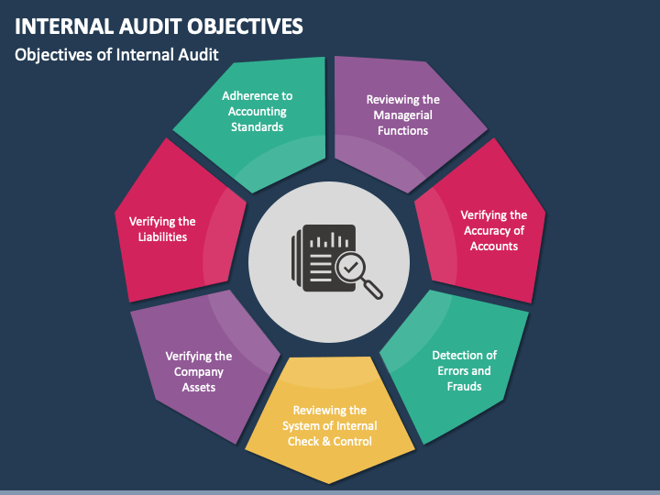

Slide 12
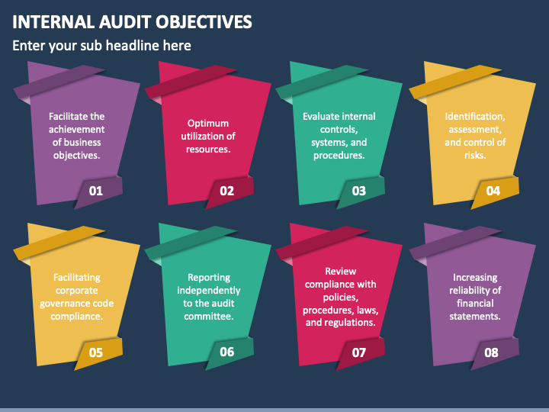

Slide 13
Coordination between Internal Audit and Risk Management Perspective
The process of risk management and internal audit functions is very important to the success, sustainability of the organization, and risk management is a vital element that is based on uncertainty about the events or outcomes that can occur have the main impact on the achievement of the strategies of the institution.
Despite the distinguished role for the internal auditor in providing advice, support to the correct administrative decisions, and attempting to address administrative decisions that appear to be inappropriate, but the process of control and risk management falls under the responsibility of senior management and the board

Slide 14
Internal Auditors’ Possible Stakeholders
Key Stakeholders
Audit committee/board
CEO
Secondary Stakeholders
Other business unit executives
External auditors and regulators
Investors and creditors
Tertiary Stakeholders
CFO or individual to whom CAE reports administratively
Potentially, other chief officers
(Government audit) citizens and taxpayers
Employees and retirees
Investment analysts
Potentially, the general public

Slide 15
Management can be more efficient about what to explore. For example, while external financial audits must test an entire financial system, a company may be concerned about whether the cash management process is being fraudulently managed; therefore, management can elect to have all audit procedures analyze cash processes.
Internal audits may save companies money. If a company's processes are very strong, the external audit process may not be as long as intensive, thereby reducing the external audit fee and time spent supporting external auditors.
The company enhances its control environment. Even if the internal audit yields no findings, employees may be aware that their work gets analyzed and reported on, thereby motivating adherence to company policy.
Internal audits may make companies more efficient. External audits often are not intended to make processes better; they are meant to review whether processes are accurate. This distinction is important because a company may be "just getting by" with inefficient processes that meet very minimum requirements.
Internal audit reports give management a head start to make corrections. Instead of having to scramble when an external audit finds a deficiency, management can take longer to think through solutions, implement the solution with care, and review whether the solution worked.
Certain departments may need enhanced oversight. Whether it is lack of expertise, staffing shortages, or problem with current personnel, a company may benefit from targeting a specific area and formally reviewing its workflow and processes.

Slide 16
5 Cs in Internal Audit
Internal audit reports often outline the criteria, condition, cause, consequence, and corrective action. These five areas report why the audit was performed, what caused the reason for the audit, how the audit will be performed, what the auditor aims to achieve, and what steps will be taken after the audit findings are presented.

Slide 17
THANK YOU

